Slide 1
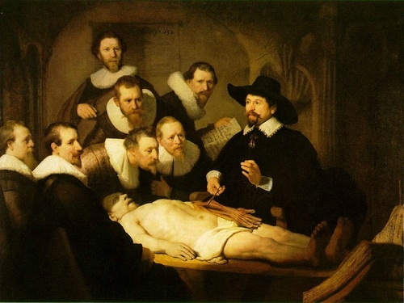

Slide 2
Demonstrations

Slide 3
Demonstrations
David Stark
Columbia University

Slide 4
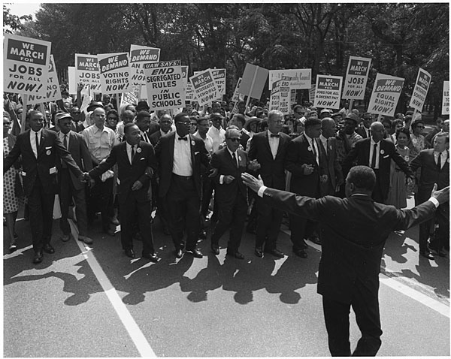

Slide 5
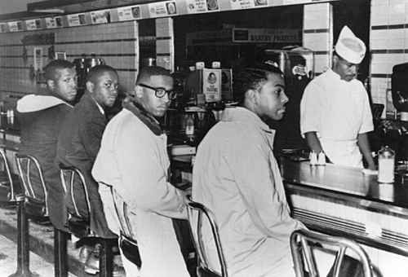

Slide 6
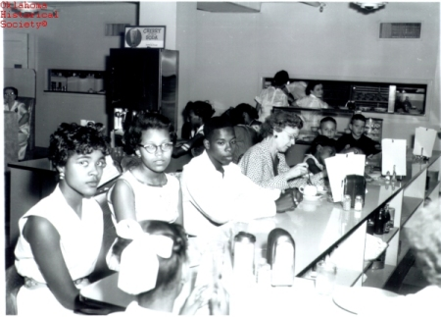

Slide 7
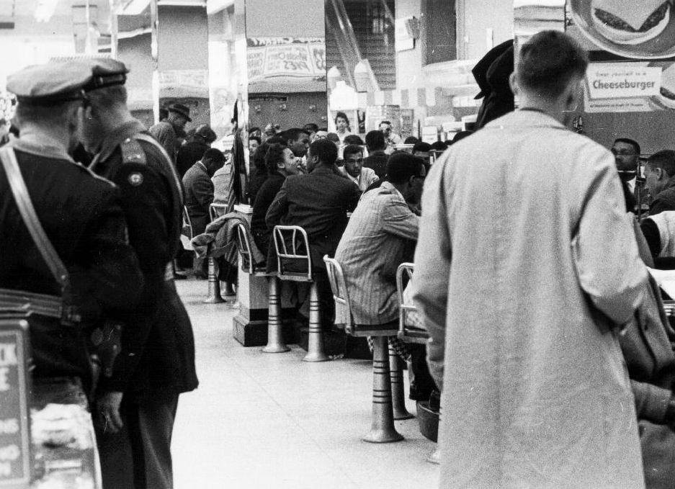

Slide 8
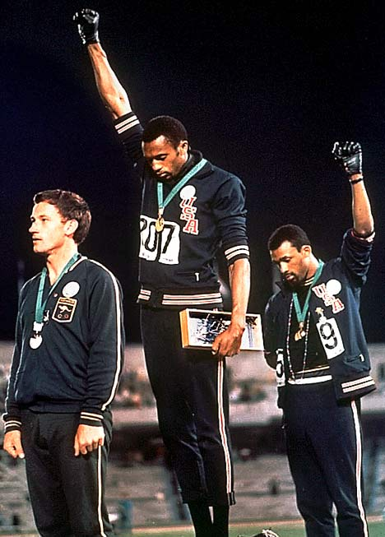

Slide 9


Slide 10
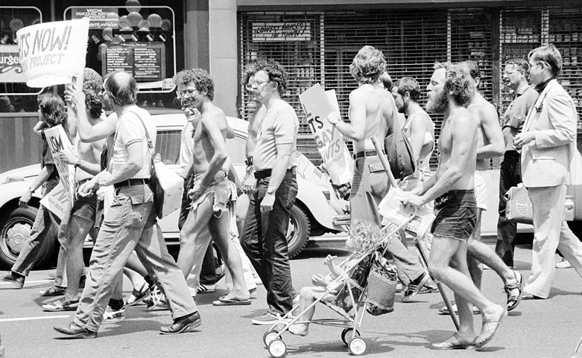

Slide 11


Slide 12


Slide 13


Slide 14


Slide 15
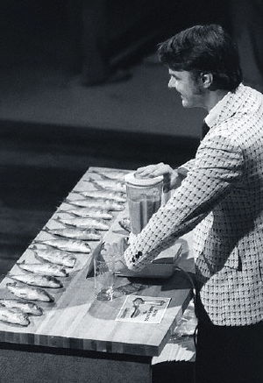

Slide 16


Slide 17


Slide 18


Slide 19
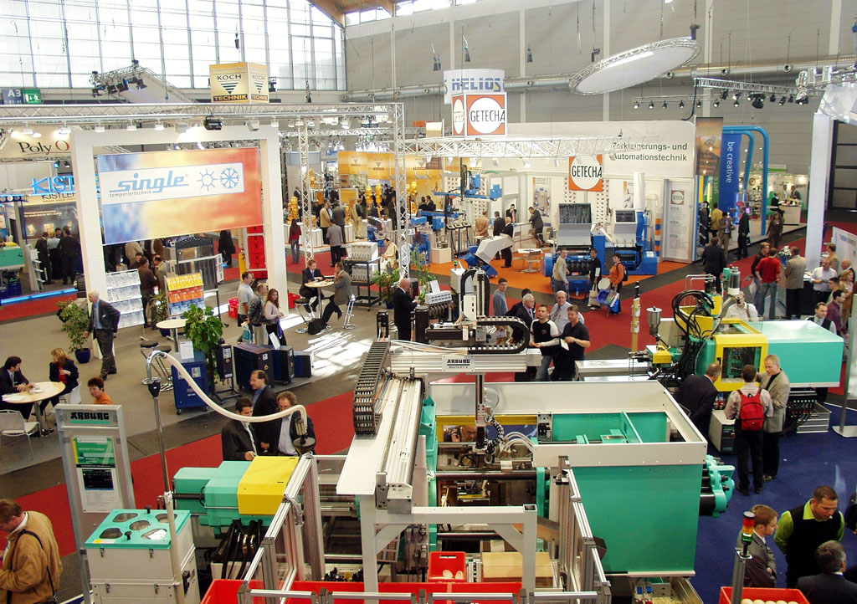

Slide 20
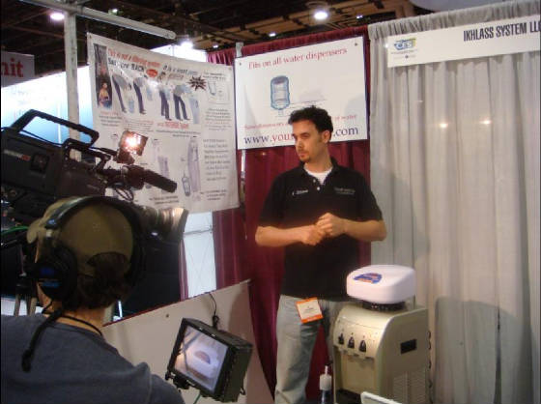

Slide 21
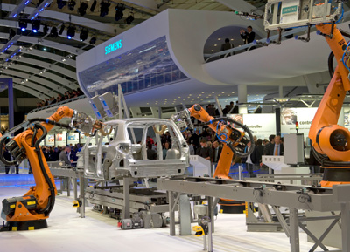

Slide 22
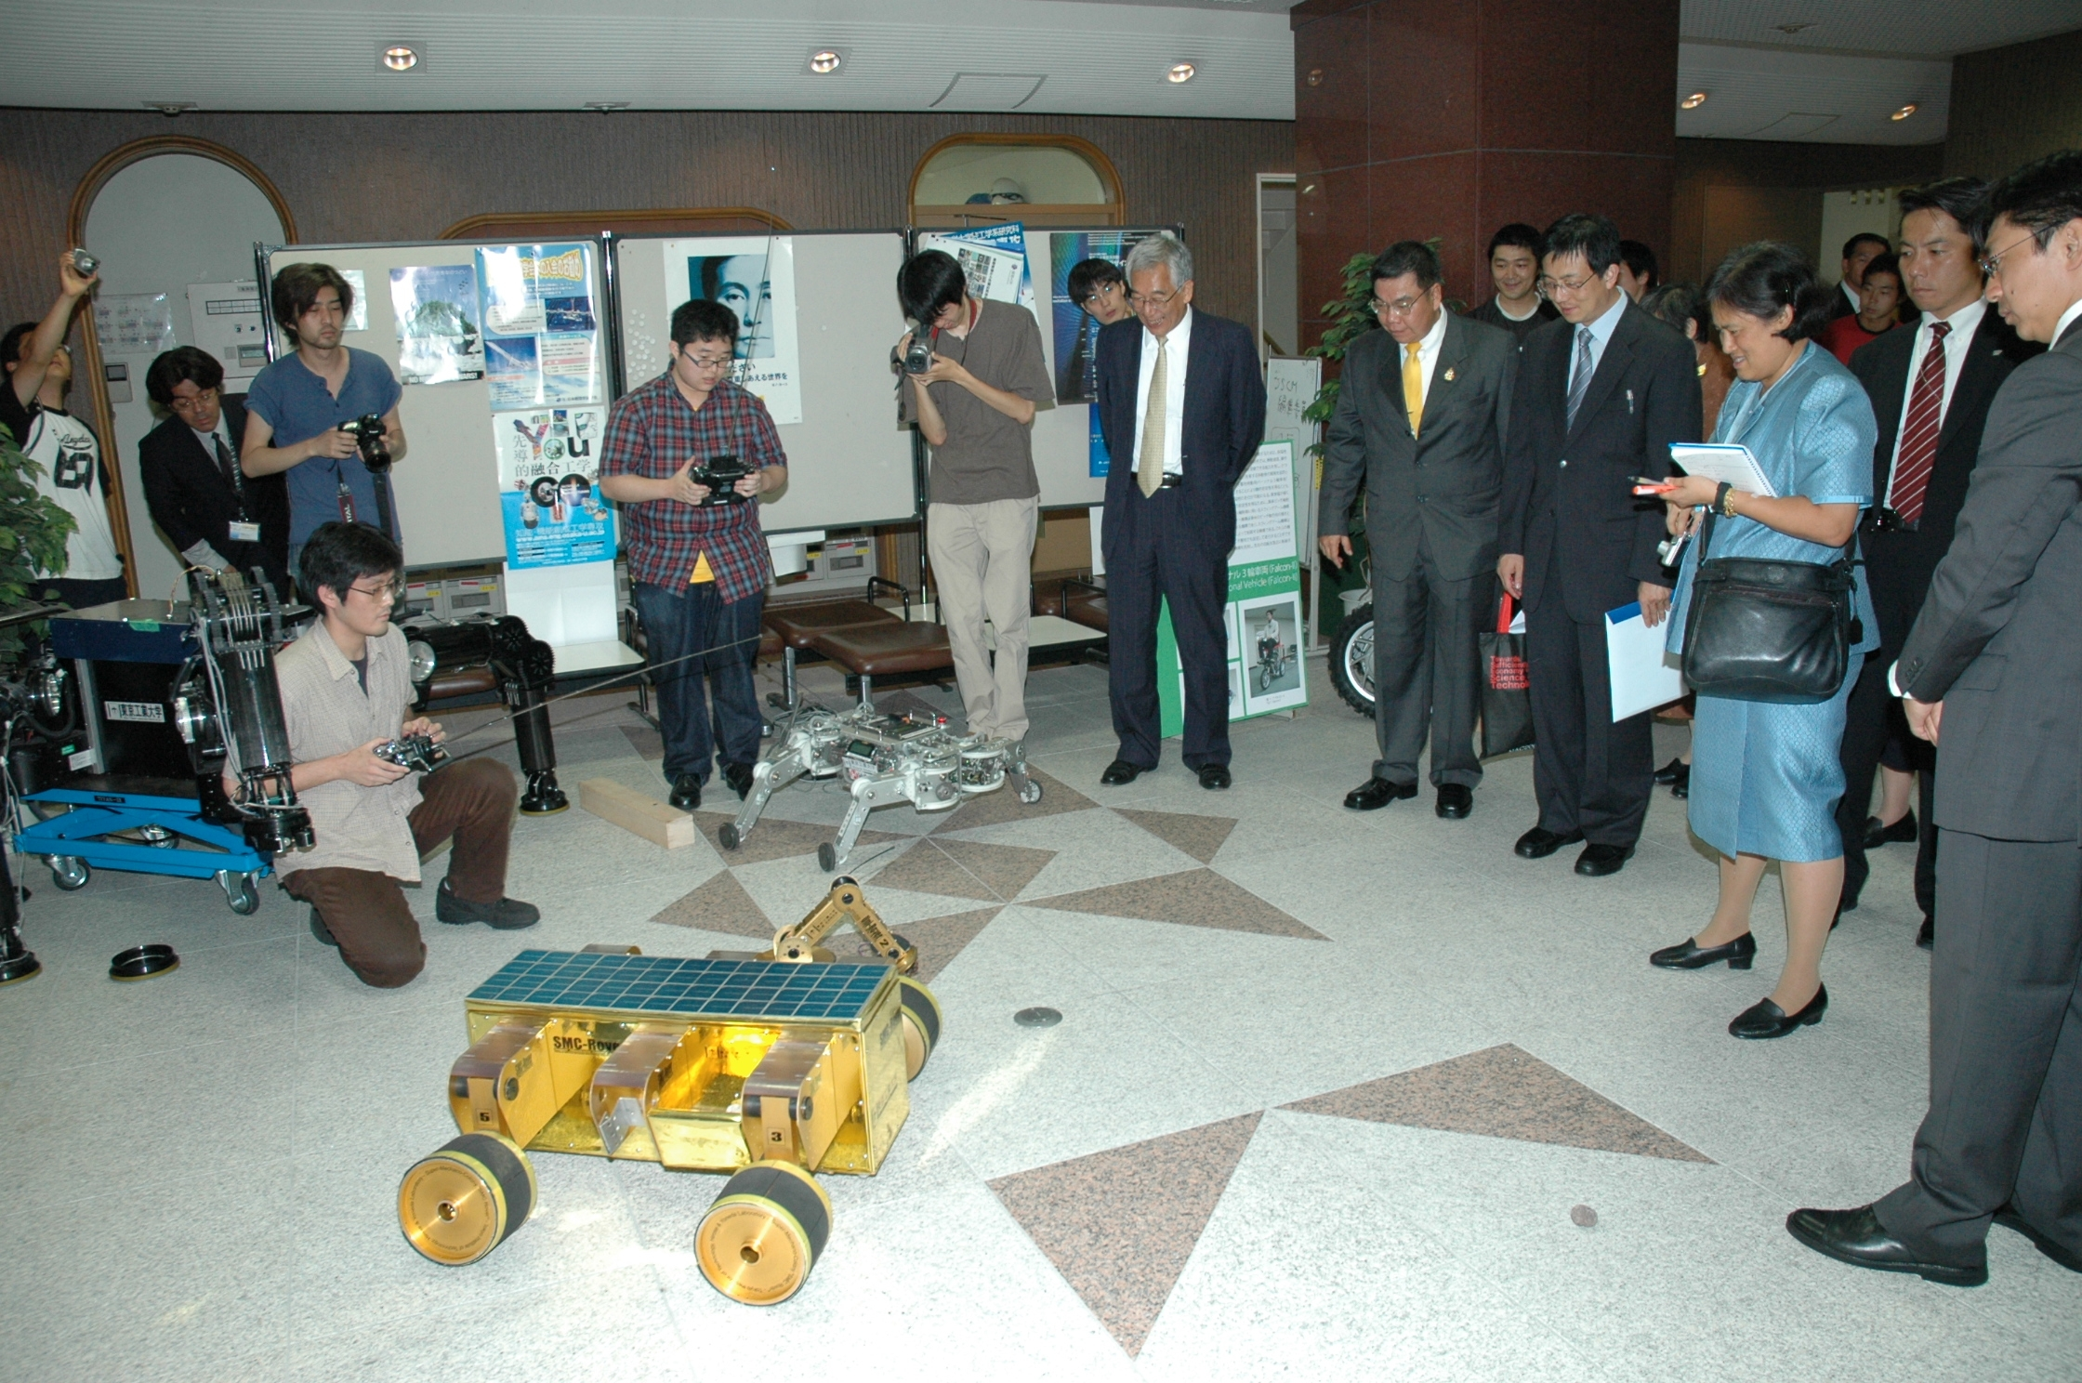

Slide 23
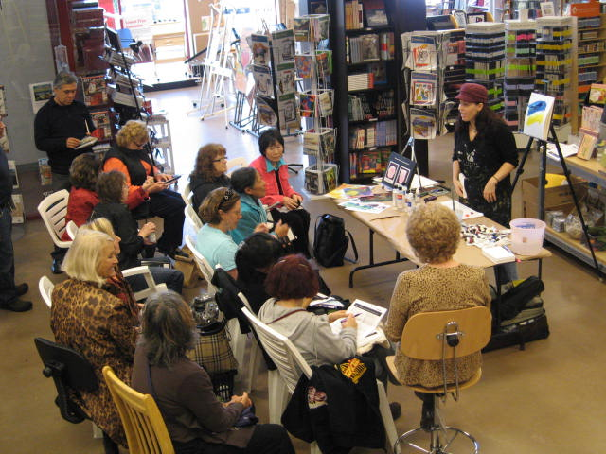

Slide 24
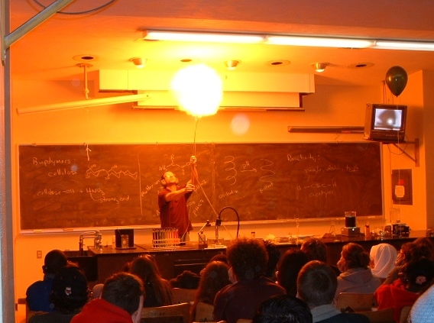

Slide 25
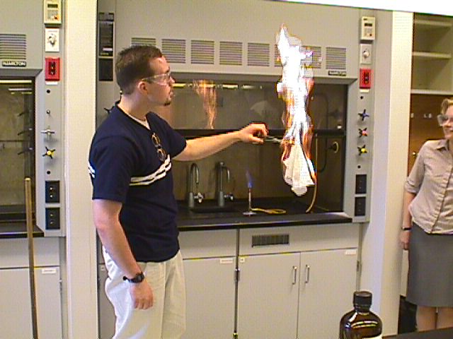

Slide 26
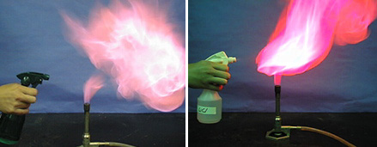

Slide 27
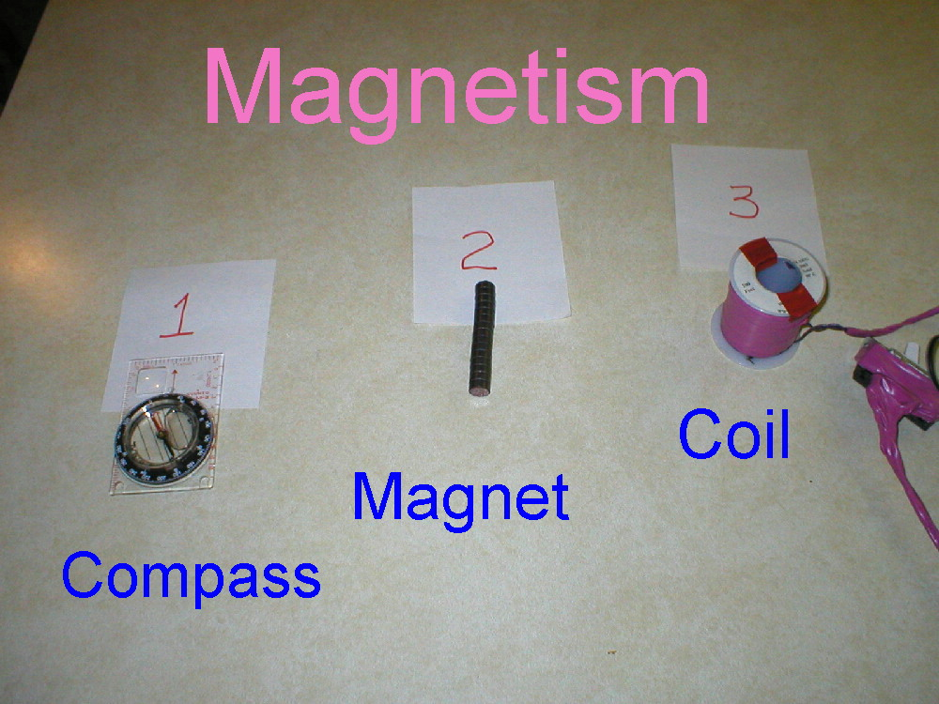

Slide 28
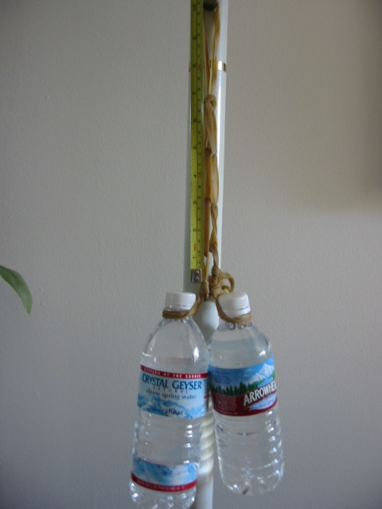

Slide 29
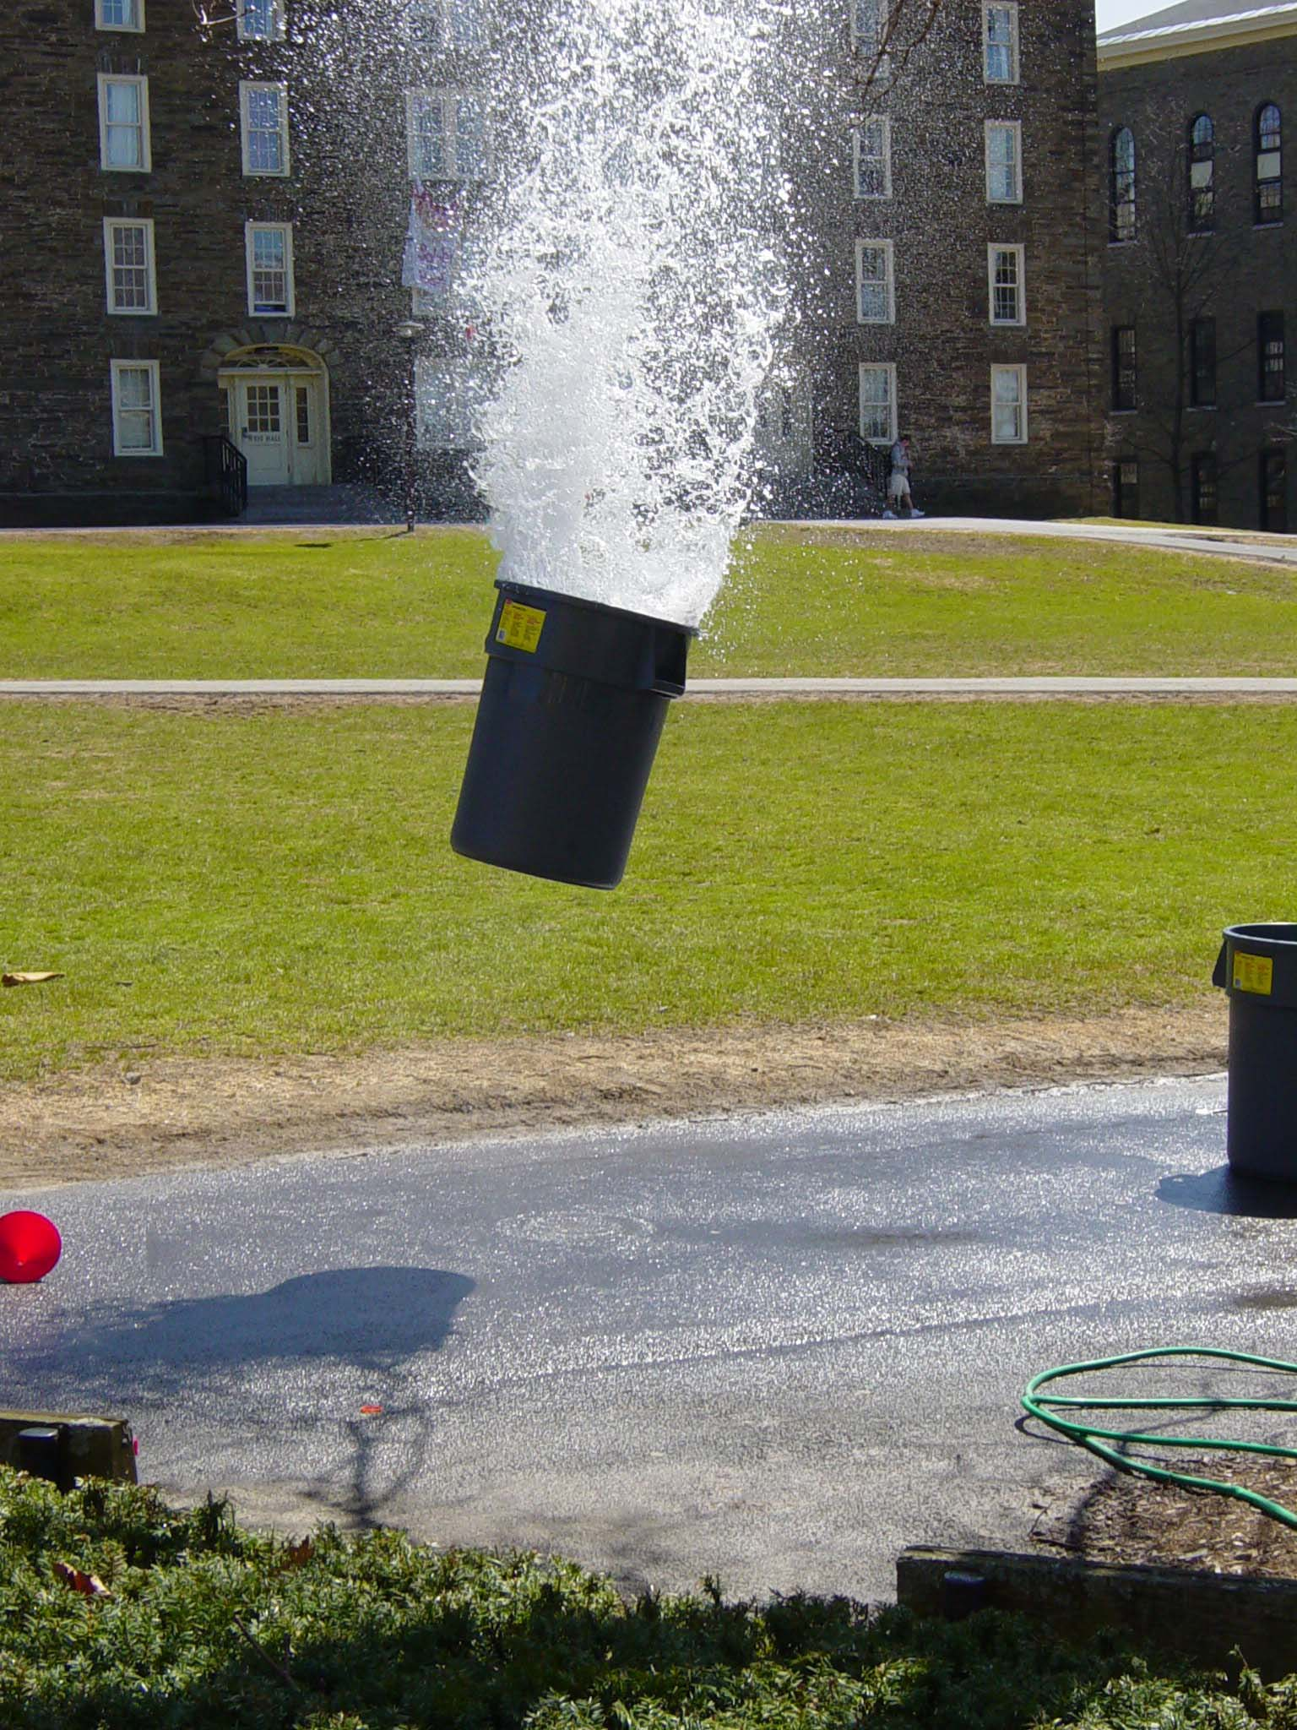

Slide 30
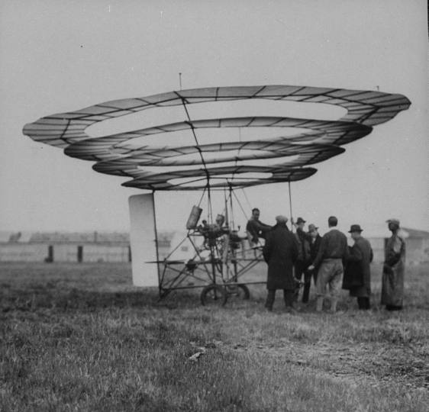

Slide 31
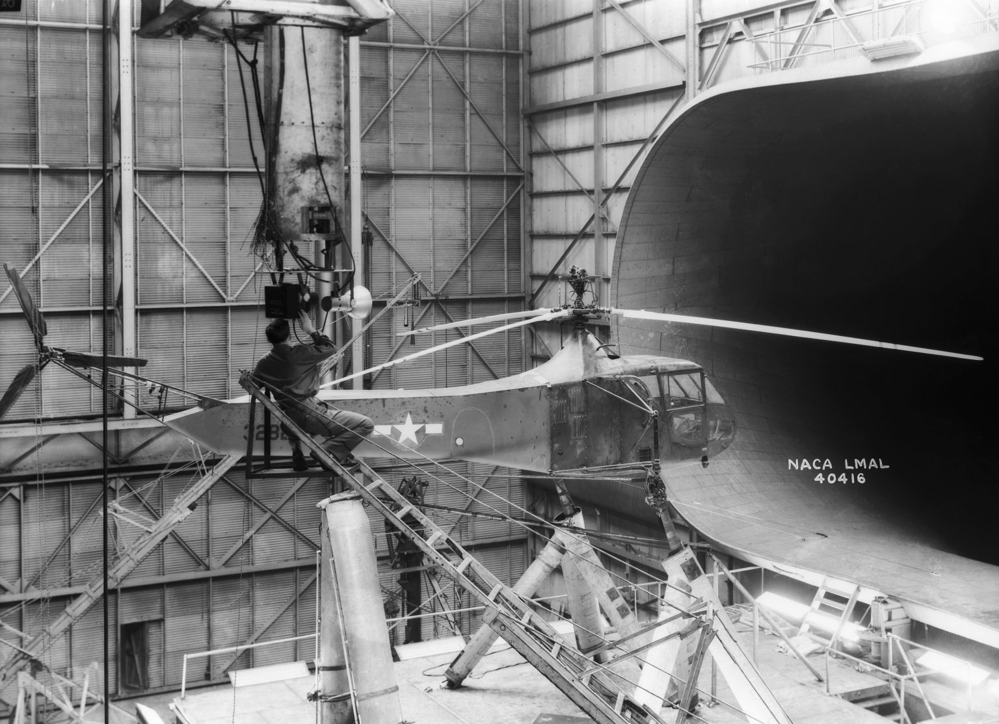

Slide 32


Slide 33
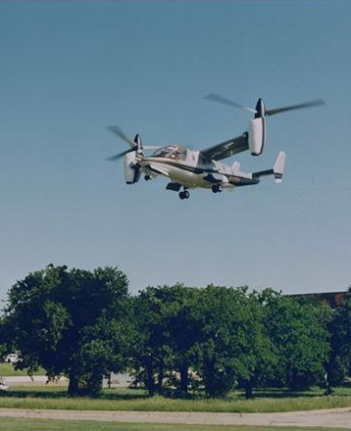

Slide 34


Slide 35
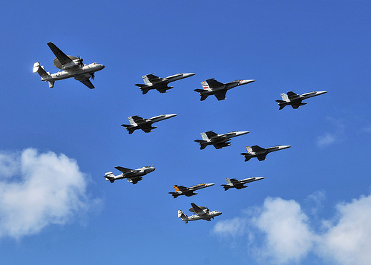

Slide 36


Slide 37


Slide 38
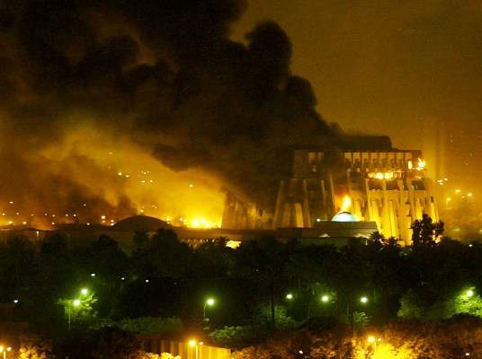

Slide 39
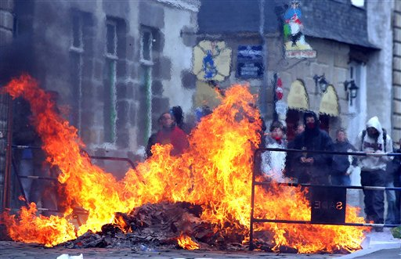

Slide 40


Slide 41


Slide 42
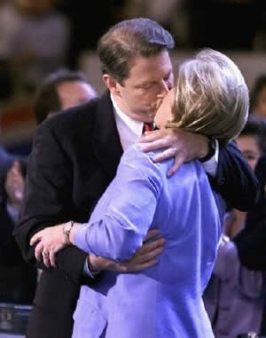

Slide 43


Slide 44
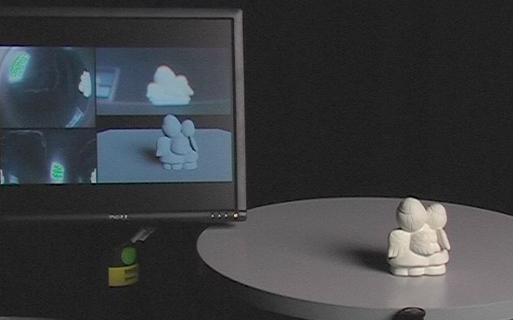
Proof of concept

Slide 45
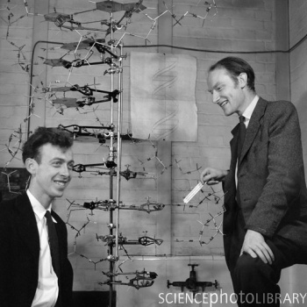

Slide 46
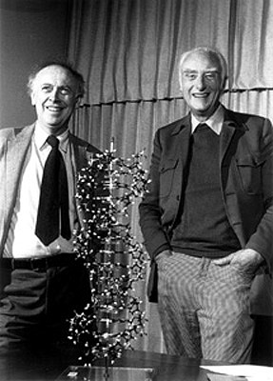

Slide 47
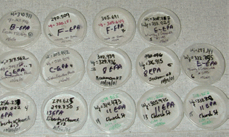

Slide 48
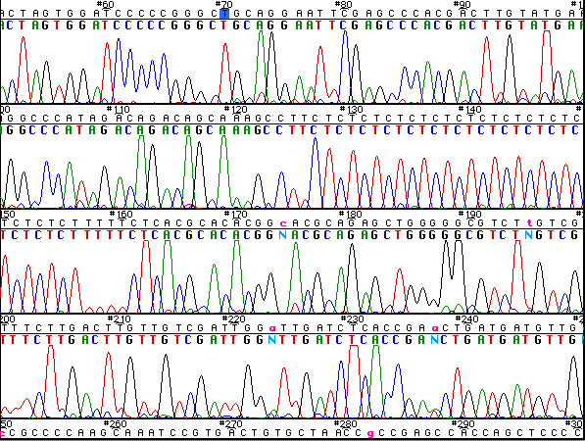

Slide 49
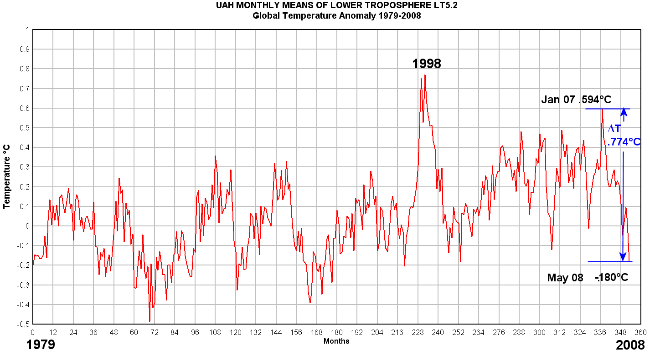

Slide 50
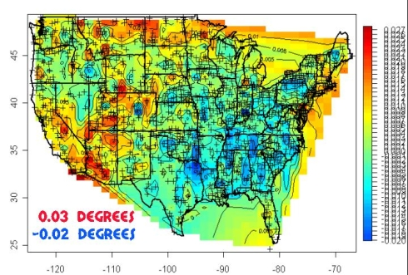

Slide 51
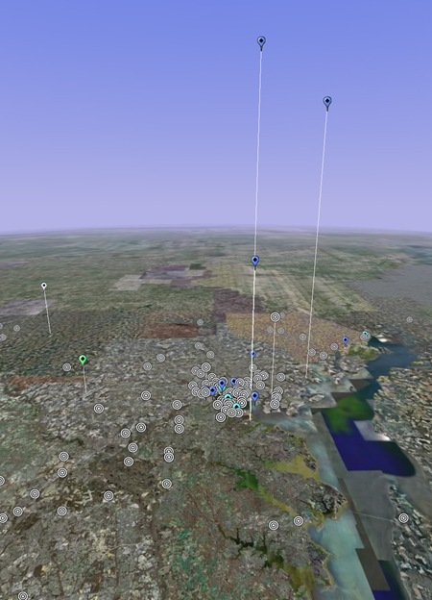
Google Earth for Air Emissions

Slide 52


Slide 53
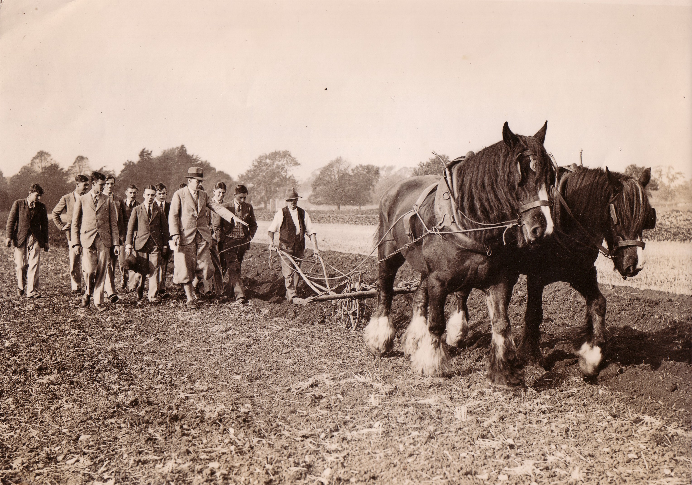

Slide 54
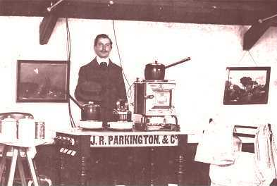

Slide 55
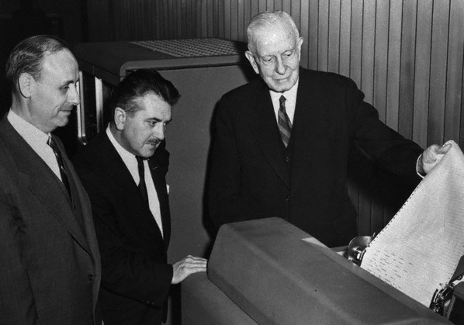

Slide 56
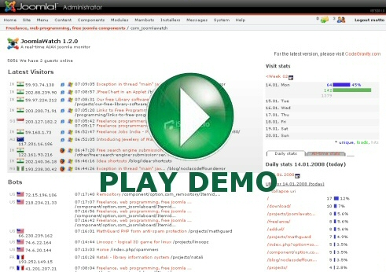

Slide 57
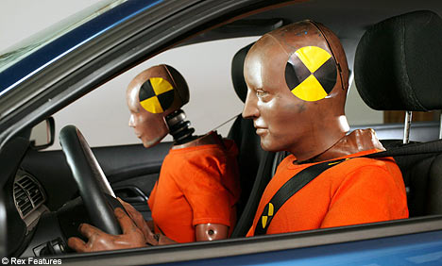

Slide 58
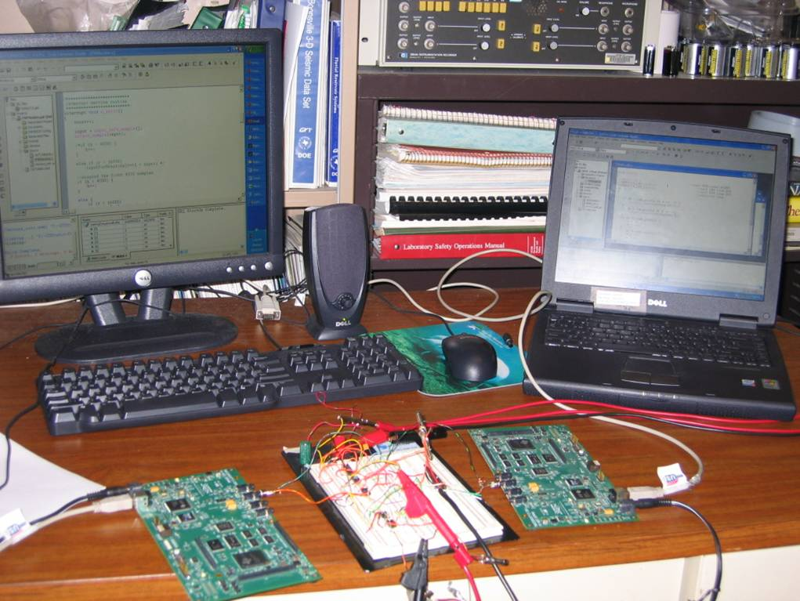

Slide 59
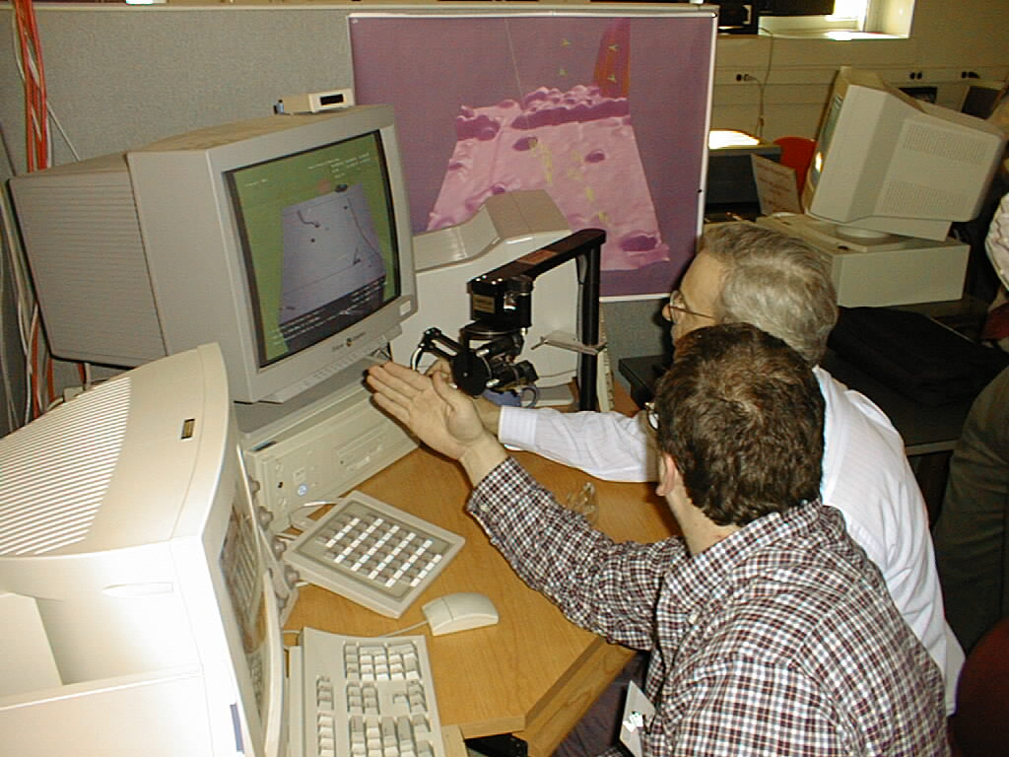

Slide 60
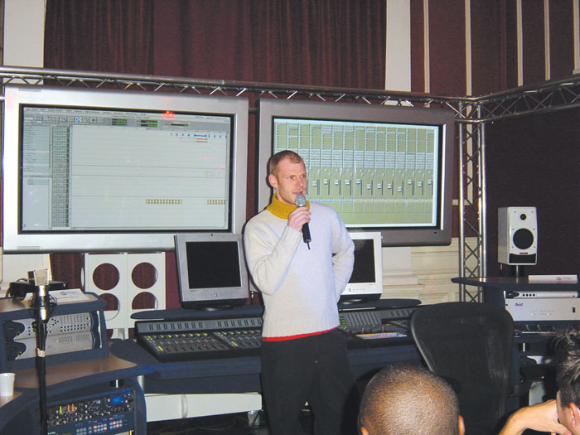

Slide 61
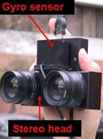
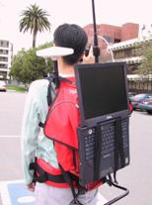
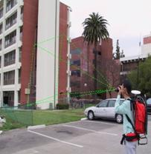

Slide 62


Slide 63
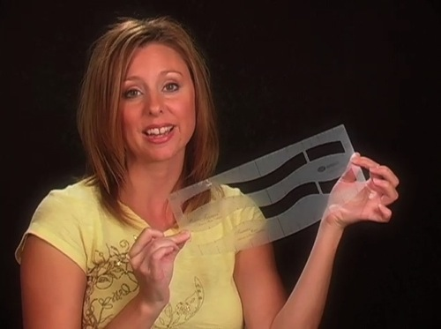

Slide 64
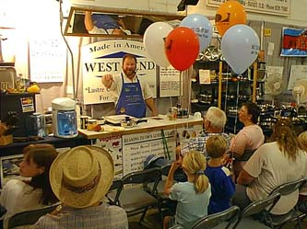

Slide 65


Slide 66
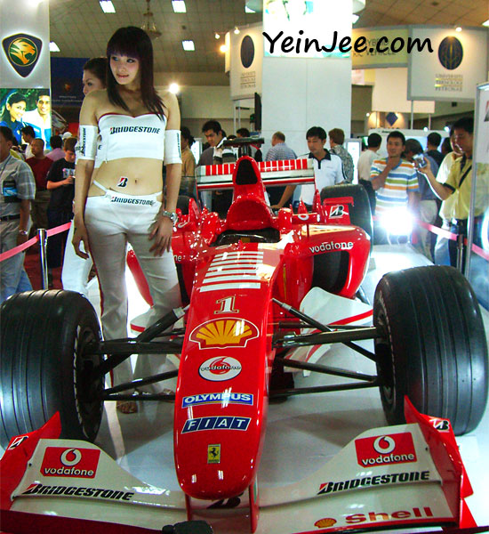

Slide 67


Slide 68


Slide 69
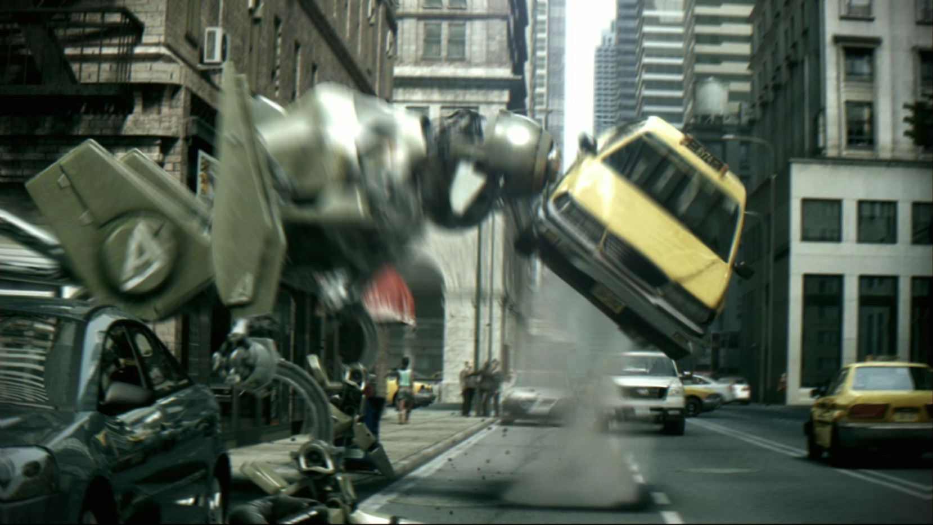

Slide 70
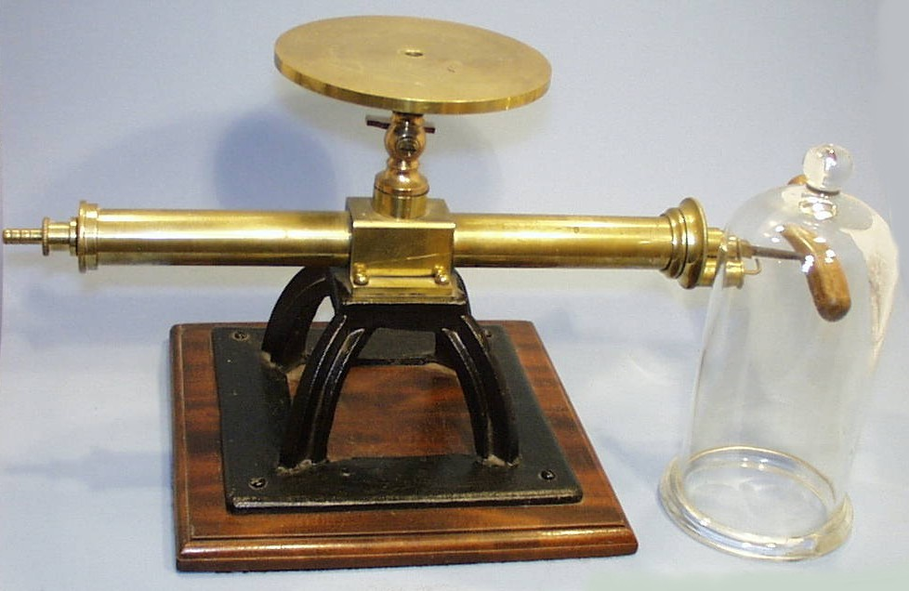

Slide 72


Slide 73


Slide 74


Slide 75


Slide 76


Slide 77

Notes:
The power of ptt is not the scale, it is not that you can import it on a larger screen , NO.

Slide 78
Notes:
The power of ptt is not the scale, it is not that you can import it on a larger screen , NO.

Slide 79


Slide 80

Notes:
The power of ptt is not the scale, it is not that you can import it on a larger screen , NO.

Slide 81
Notes:
The power of ptt is not the scale, it is not that you can import it on a larger screen , NO.

Slide 82
Notes:
The power of ptt is not the scale, it is not that you can import it on a larger screen , NO.

Slide 83
Notes:
The power of ptt is not the scale, it is not that you can import it on a larger screen , NO.

Slide 84


Slide 85


Slide 86


Slide 87


Slide 88


Slide 89


Slide 90


Slide 91


Slide 92


Slide 93


Slide 94


Slide 95


Slide 96


Slide 97


Slide 98


Slide 99


Slide 100


Slide 101


Slide 102


